Slide 1
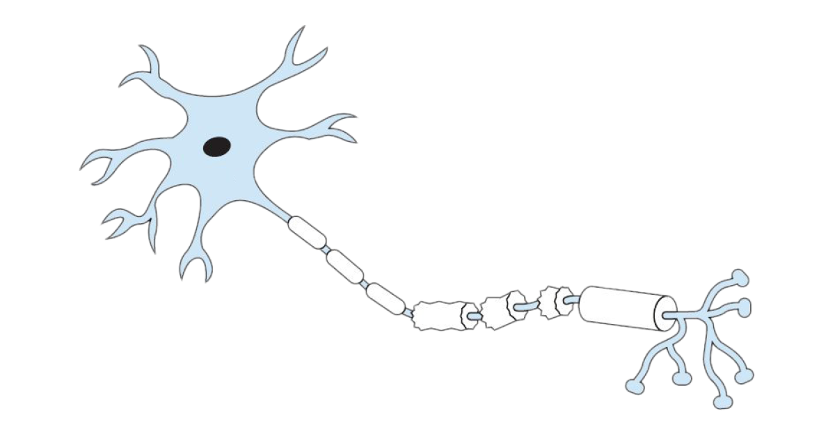
Project 1:
Normalization as a canonical neural computation
➗
Jack Gabel, Sol Markman, Quilee Simeon, Hokyung Sung
PSY 1401 Group 2 Project 1

Slide 2
Outline
Normalization reduces redundancy in natural image
Normalization induces winner-takes-all dynamics
Normalization produces light adaptation in the retina
Empirical evidence for normalization
Biologically plausible mechanisms of normalization
Discussion

Slide 3

Spatial autocorrelation in naturalistic images
Similar, close
Different, far
Pixels that are closer together in space tend to be more correlated.
Therefore, representing every pixel as is is redundant.
Instead, the visual system should highlight differences between neighboring pixels.

Slide 4
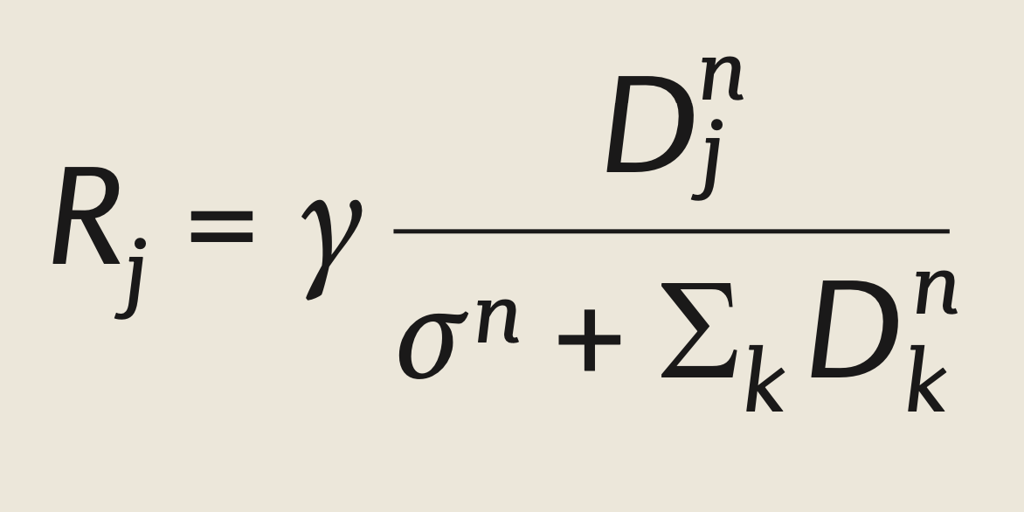
The normalization equation
Carandini & Heeger 2012
𝛄, 𝝈, n: free parameters
D_{j}: driving inputs to neuron j
D_{k}: the normalization pool
Visualize the effects of normalization on an image (without changing its size)?
D_{j} = 1 pixel, D_{k} = surrounding pixels

Slide 5

Normalization reduces redundancy in natural images
Before normalization
After normalization

Slide 6
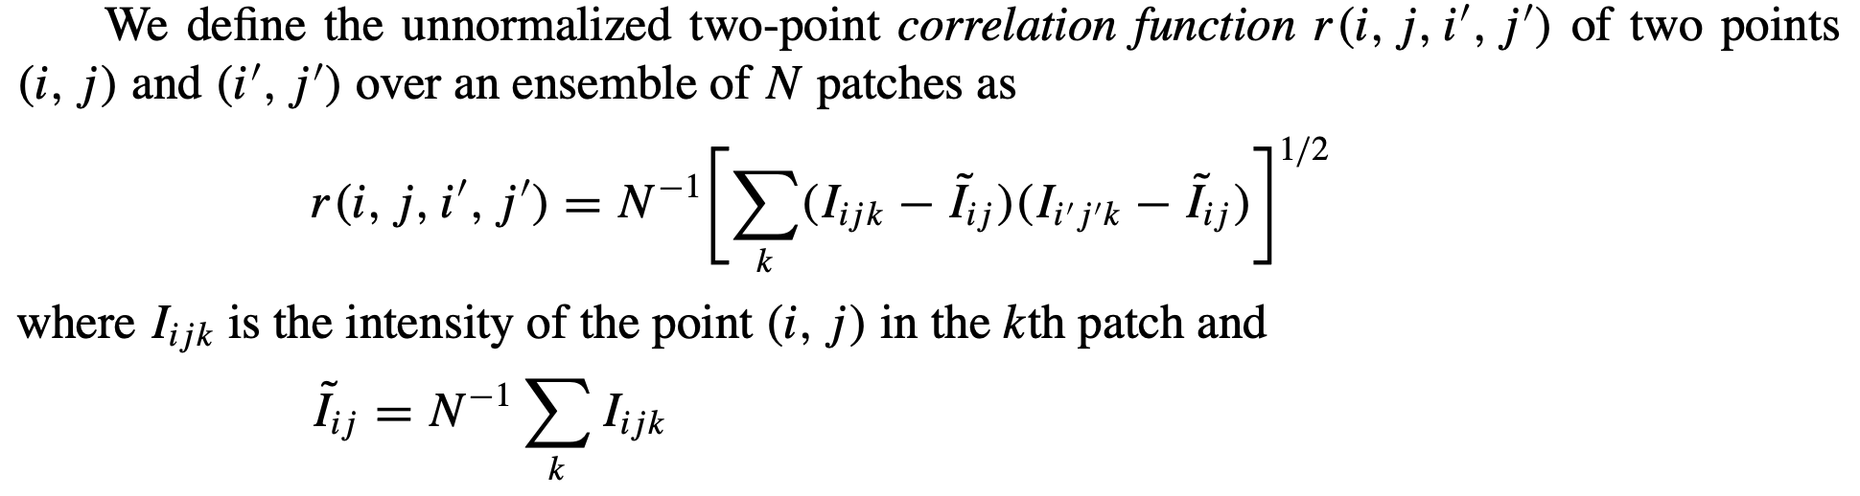

Spatial autocorrelation
Reinagel & Zador 1999

Slide 7
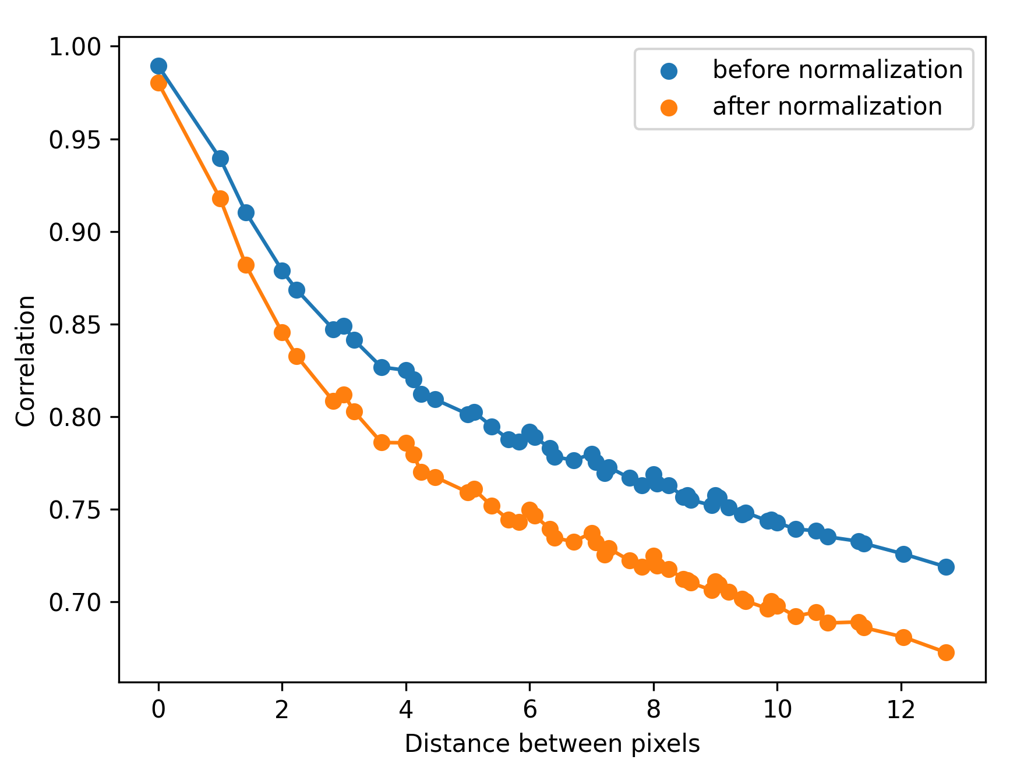
Normalization reduces redundancy in natural images

Slide 8
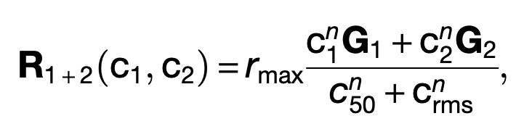
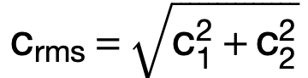
Normalization induces winner-takes-all competition
Busse, L., Wade, A. R., & Carandini, M. (2009). Representation of concurrent stimuli by population activity in visual cortex. Neuron, 64(6), 931-942.
Notes:
What is winner take all competition?
A neural computation in which the response depends on the maximum of the inputs.
Why do we care?
This has been found in the brain. For example, V1 populations exhibits strong winner-take-all competition in response to sums of stimuli with different contrasts
Describe the equation.
Normalization function expressed in such a way that we can evaluate the population response to two different stimuli that are presented simultaneously. It’s from the paper cited here.
R is population response. Rmax, C50, and n are constants. G1 and G2 are gaussians distributions that we use to simulate the neurons. c1 and c2 are the contrasts of the stimuli. Root mean square of the contrasts is Crms
How does normalization induce it?
the presence of multiple stimuli effectively raises the constant in the denominator, reducing the sensitivity of the neurons to the point that the weaker stimuli become unable to drive the response.

Slide 9
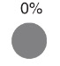
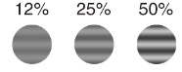
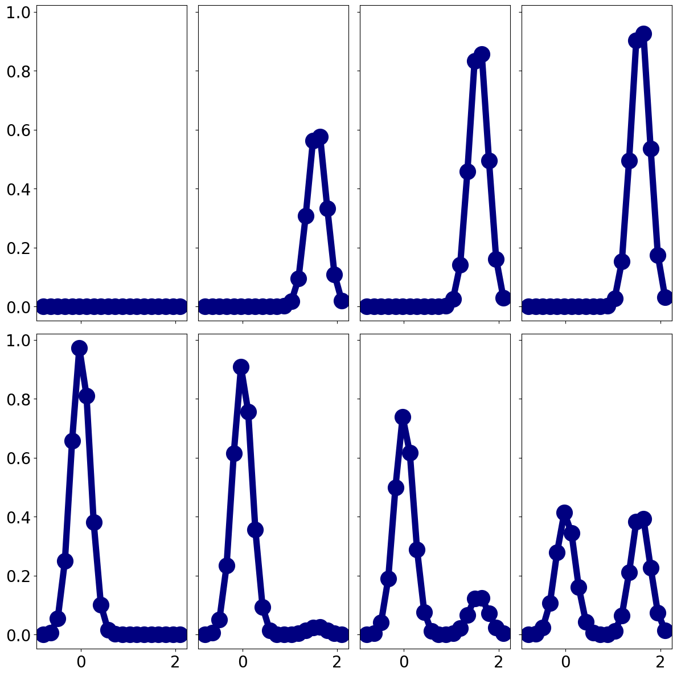


Normalization induces winner-takes-all competition
Notes:
Simulated population of 20 neurons tuned to different orientations. X axes are different orientations in radians. Y axes are neural responses.
Grating stimuli are shown. Top row is presented alone, bottom row are plaids.
Top row increases with contrast
Bottom row, higher contrast stimulus overpowers the lower contrast stimuli until they reach 50/50, even though they elicit normal response when presented alone.

Slide 10
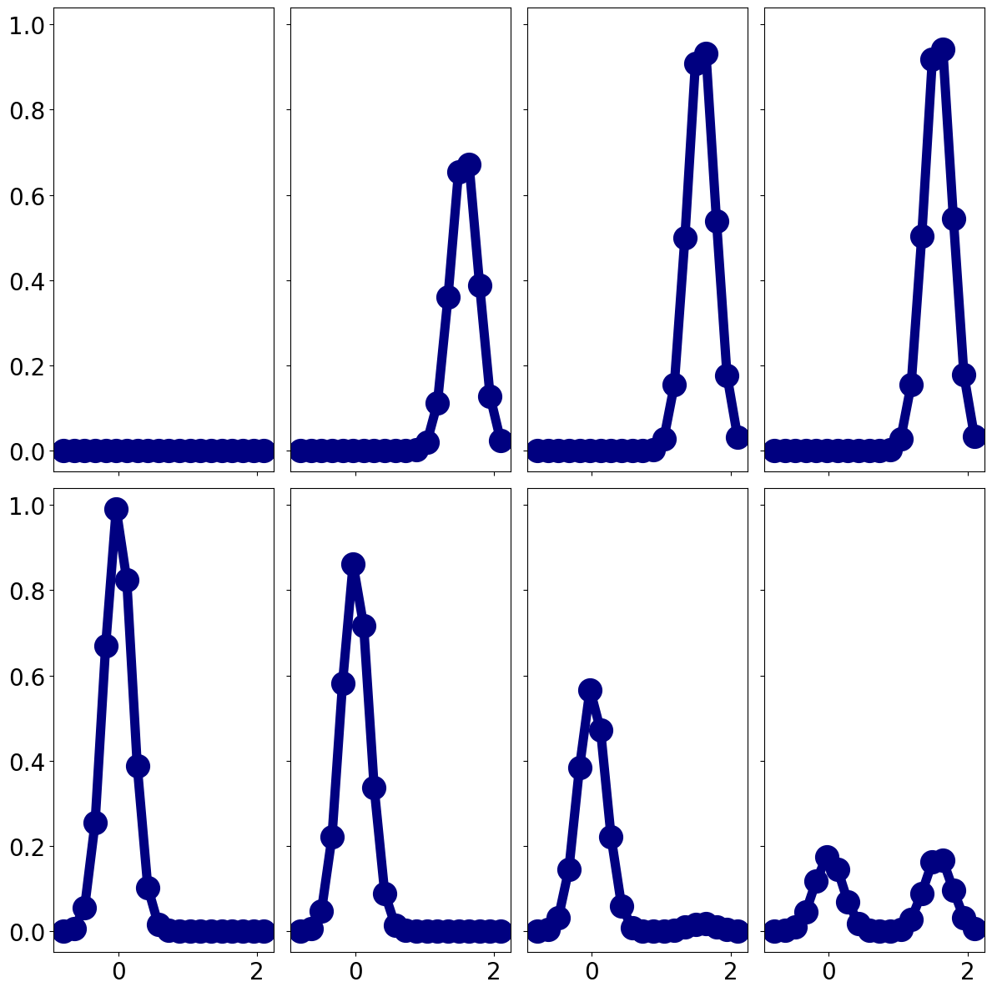
Normalization induces winner-takes-all competition
n = 5
Notes:
What happens if we increase n? Larger n amplifies the effect by further increasing the denominator.

Slide 11
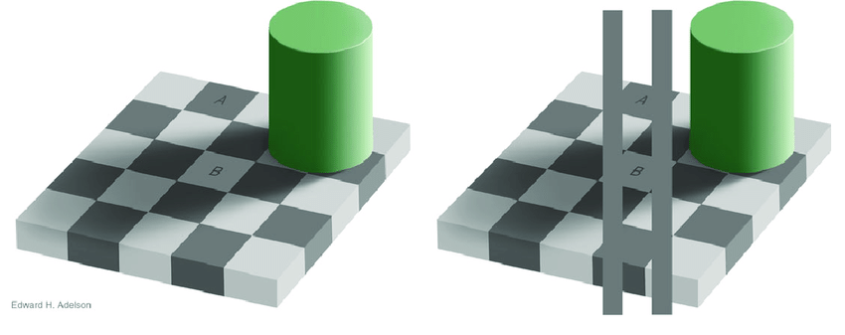
3. A visual illusion
Notes:
Lol, I still see different shades; Only works for me if you fully cover the rest of the image; (see hidden slide). - Quilee

Slide 12
3. A visual illusion

Slide 13
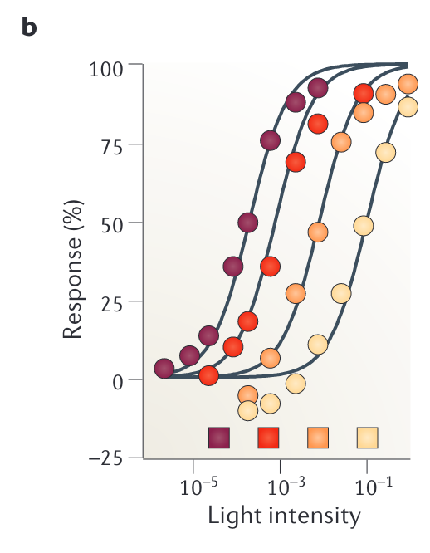
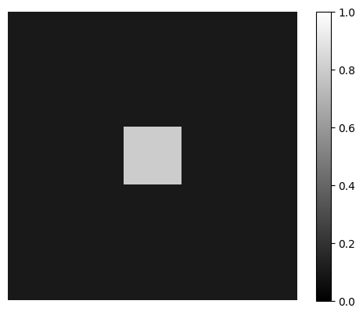
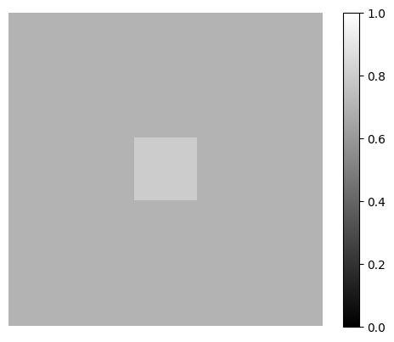
Light adaptation in the retina

Slide 14
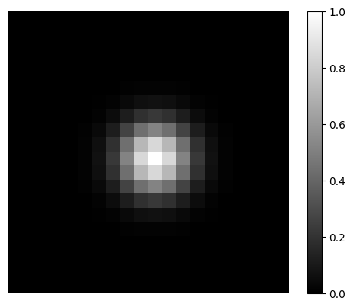
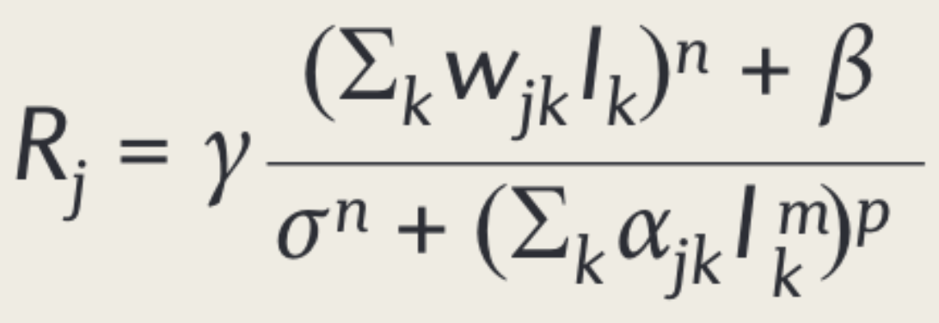
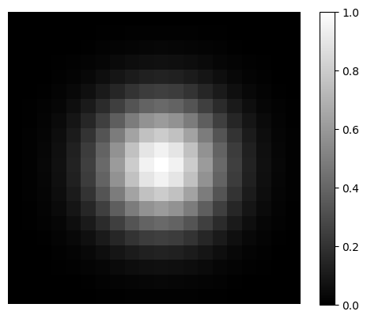
Normalization produces light adaptation in the retina
summation field (W)
Average the normalization signal recent time, so that in effect, the suppressive field becomes larger
input image
suppressive field (Alpha)

Slide 15
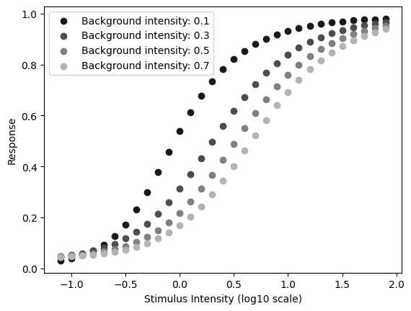
Normalization produces light adaptation in the retina
Average the normalization signal recent time, so that in effect, the suppressive field becomes larger

Slide 16
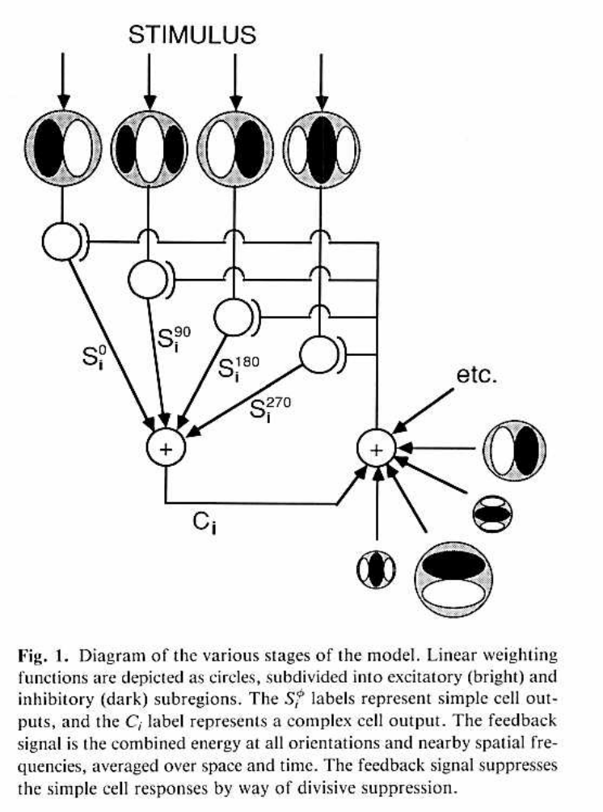
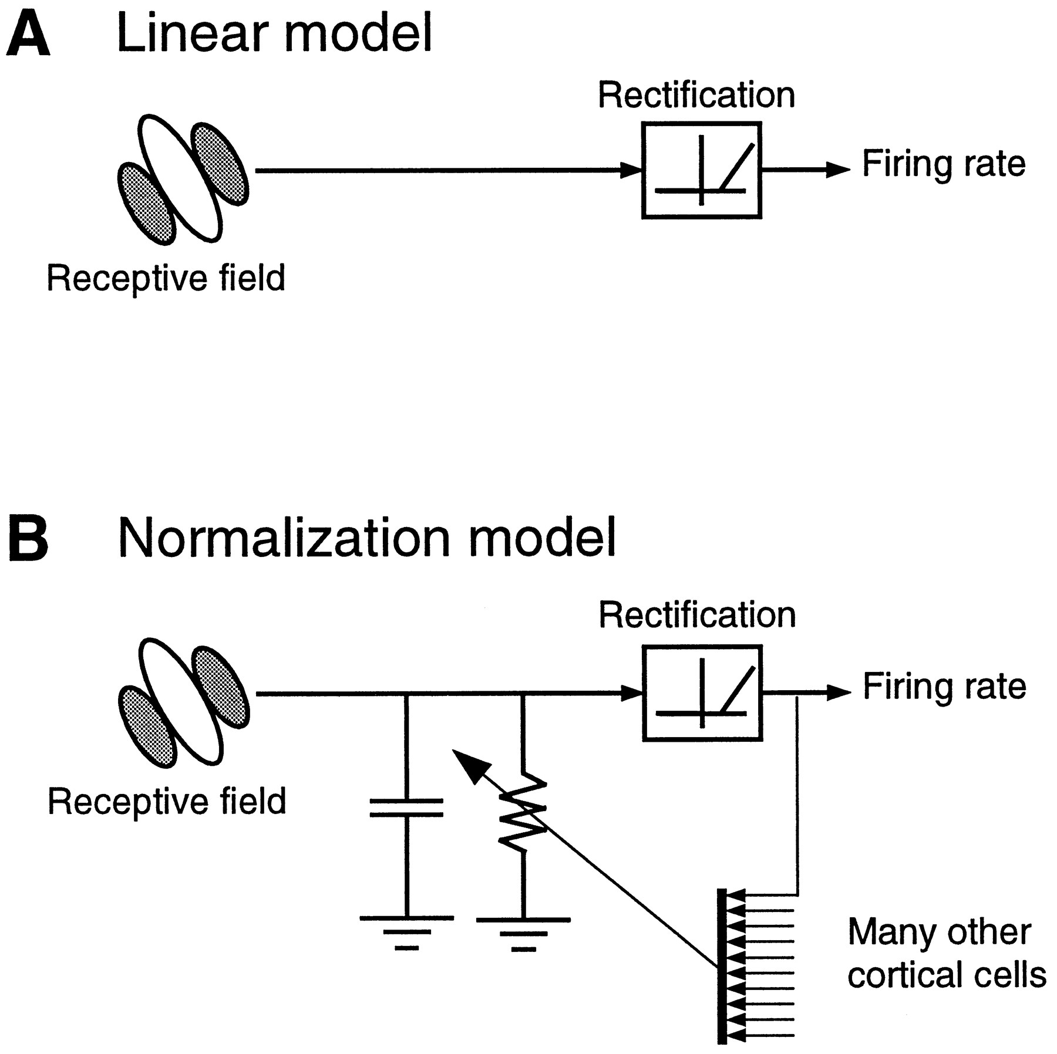
Evidence for normalization in the visual system
1. Contrast Response Saturation: Neurons exhibit a plateau in response at high contrast levels, indicating a normalized response to visual stimuli (Heeger, 1992).
2. Cross-Orientation Suppression: Presentation of orthogonal, non-preferred stimuli leads to suppression of the neuron's response to the preferred orientation, aligning with the normalization model (Carandini and Heeger, 2012).
3. Surround Suppression: Visual stimuli evoke diminished responses when additional stimuli are present in the surrounding area, suggesting the involvement of a normalization mechanism (Cavanaugh et al., 2002).
4. Attentional Modulation: Directed attention enhances responses to stimuli, as predicted by normalization models incorporating attentional gain factors (Reynolds and Heeger, 2009).
5. Population Responses: Collective neural behavior in response to complex stimuli follows normalization predictions, including winner-take-all dynamics (Carandini et al., 1997).
6. Functional MRI Correlates: Brain activity patterns observed in fMRI studies correspond to normalization model predictions, supporting its role in human visual processing (Boynton et al., 1999).
Fig.1 from Ref. 1
Fig.1 from Ref. 5
Notes:
A wealth of scientific evidence supports normalization as a versatile and robust mechanism in visual processing, from cellular to system-level functions. The empirical evidence is interdisciplinary drawing from neurophysiology, neuroimaging, and psychophysics.
References:
Heeger, D.J. (1992). Normalization of cell responses in cat striate cortex. Visual Neuroscience, 9, 181-197.
Carandini, M., & Heeger, D.J. (2012). Normalization as a canonical neural computation. Nature Reviews Neuroscience, 13, 51-62.
Cavanaugh, J.R., Bair, W., & Movshon, J.A. (2002). Nature and interaction of signals from the receptive field center and surround in macaque V1 neurons. Journal of Neurophysiology, 88(5), 2530-2546.
Reynolds, J.H., & Heeger, D.J. (2009). The normalization model of attention. Neuron, 61(2), 168-185.
Carandini, M. et al. (1997). Linearity and normalization in simple cells of the macaque primary visual cortex. The Journal of Neuroscience, 17(21), 8621-8644.
Boynton, G.M. et al. (1999). Linear systems analysis of functional magnetic resonance imaging in human V1. The Journal of Neuroscience, 19(13), 520-528.

Slide 17
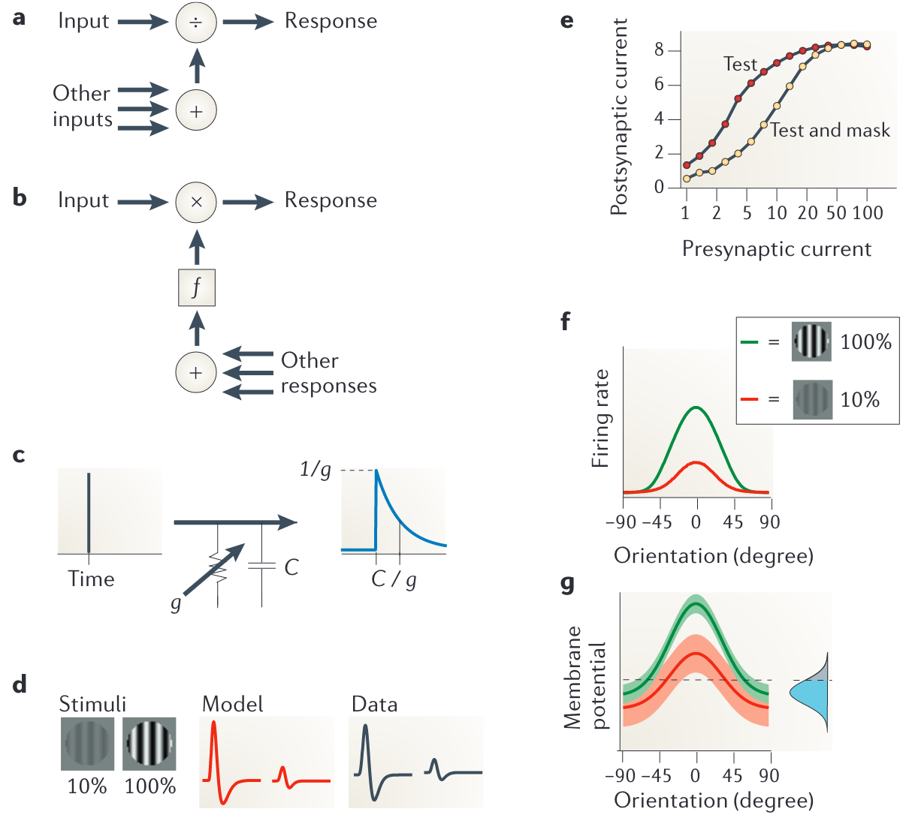
Biologically plausible mechanisms of normalization
Cellular level
Shunting inhibition (↑ conductance)
Synaptic depression
Division = GABA-mediated inhibition?
Fruit fly olfactory system ✔
Mammalian V1 ✖
“What seems to be common is not necessarily the biophysical mechanism but rather the computation”
Amplification rather than suppression
Notes:
A variety of different (feedforward and feedback) neural circuits and mechanisms might perform normalization, including presynaptic inhibition, shunting inhibition, synaptic depression, changes in the amplitude of ongoing activity and balanced amplification.
Shunting inhibition: V=I/g Ohm’s law. Mixed evidence.
Synaptic depression: only explains some effects (e.g. cross-orientation suppression (shown) but not surround suppression)

Slide 18
Discussion
What benefits might normalization offer the organism?
What makes something a “canonical neural computation”?
What are some behavioral predictions of normalization?
How might normalization shed light on neurological or psychiatric disorders?
How does the brain decide over what space to normalize? In other words, how does the brain know what the part and the whole are?
Notes:
Autism paper: https://www.pnas.org/doi/full/10.1073/pnas.1510583112

